Slide 1
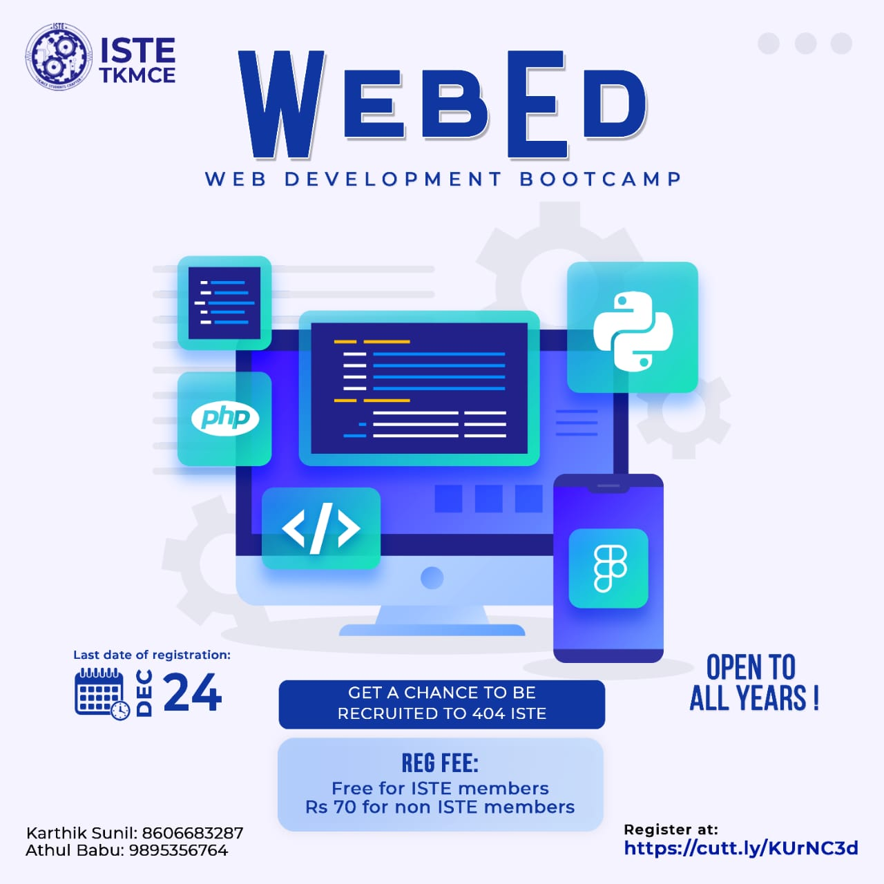
WELCOME
KARTHIK SUNIL

Slide 2
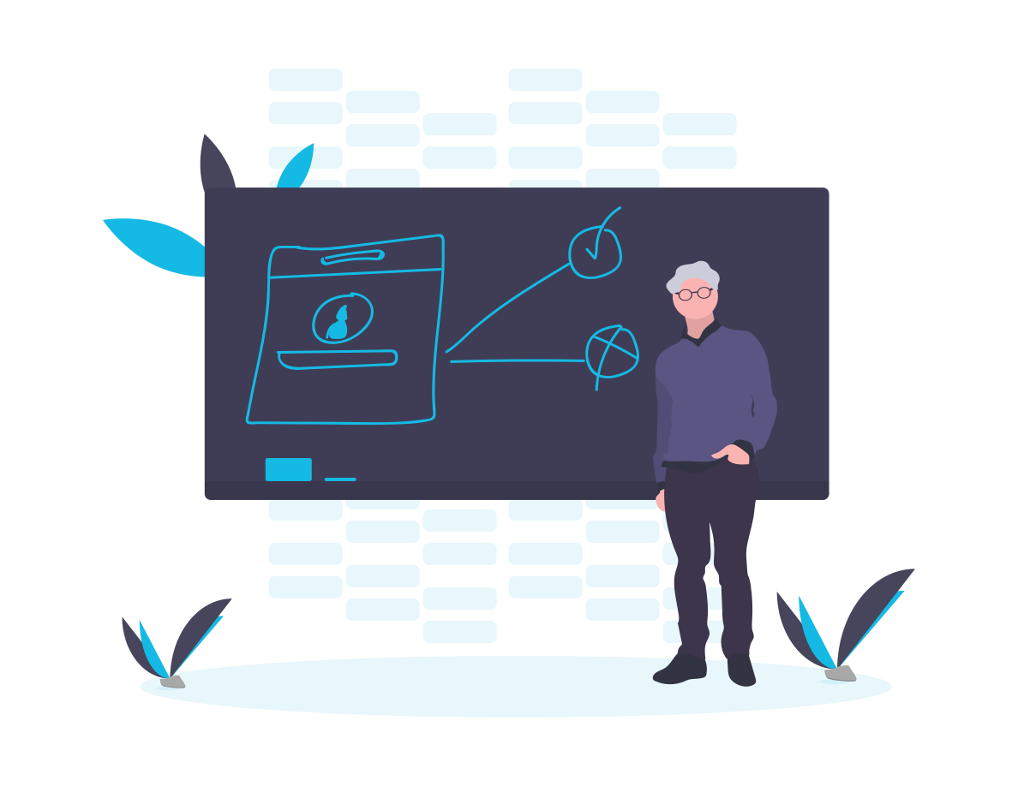
Story behind Web development

Slide 3

CLIENT vs SERVER

Slide 4

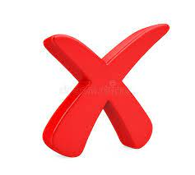
CLIENT

Slide 5
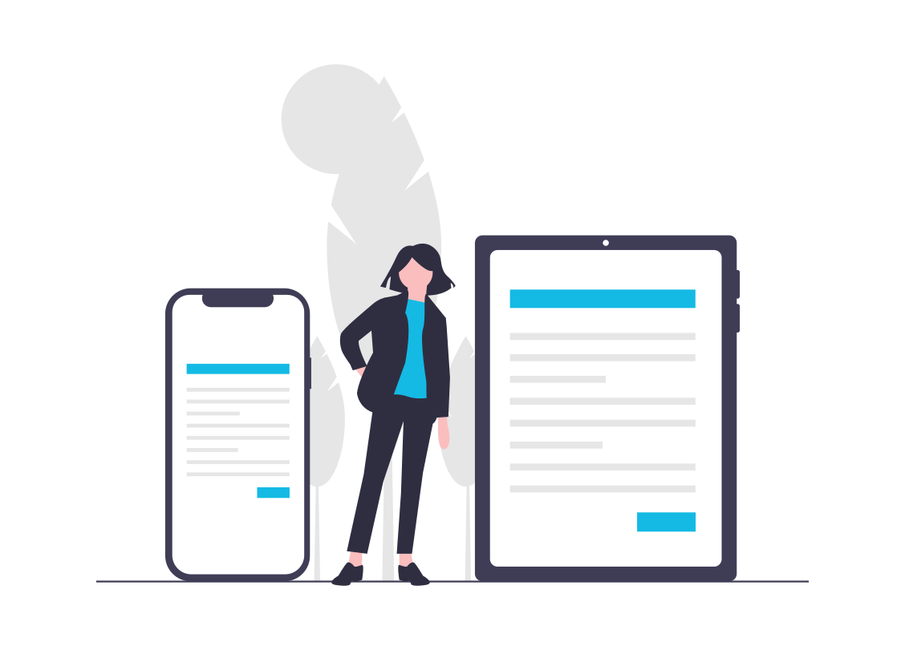
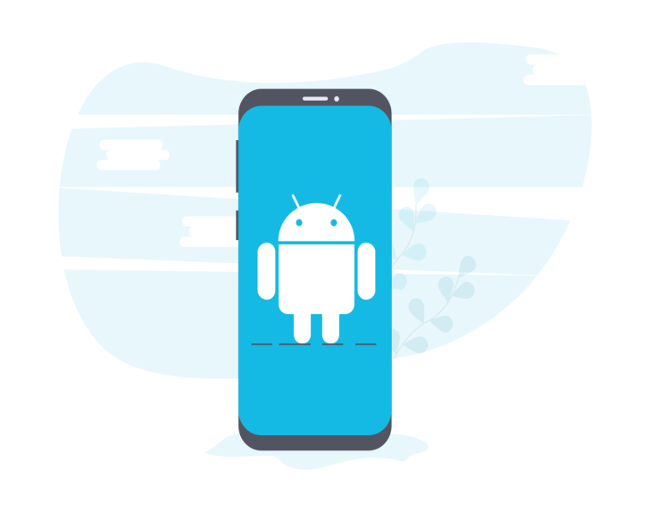

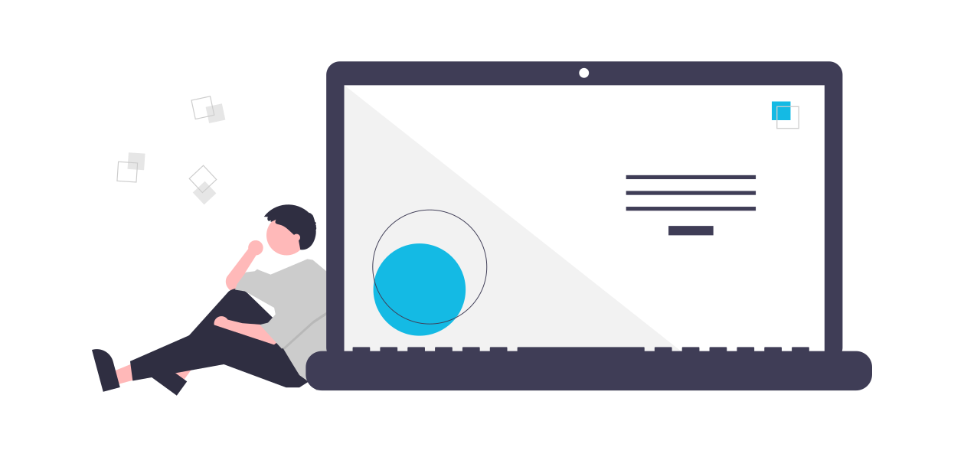
CLIENT DEVICES
<> Devices That Interacting With Servers

Slide 6

SERVER
What is Server?

Slide 7


SERVER
>https://facebook.com

Slide 8

CLIENT SERVER MODEL
>24X7 Power Supply and Internet Supply
>Affect client devices
>Eg: Bluehost Liquid Web A2 Hosting
(-companies who sells servers)

Slide 9
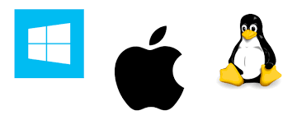
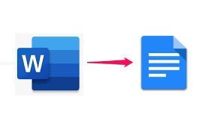
MORE ABOUT CLIENTS
Advantages
>System specification Graphics card
>Memory usage
>Architecture independent
Examples:
Microsoft live
Rive.app
Games

Slide 10
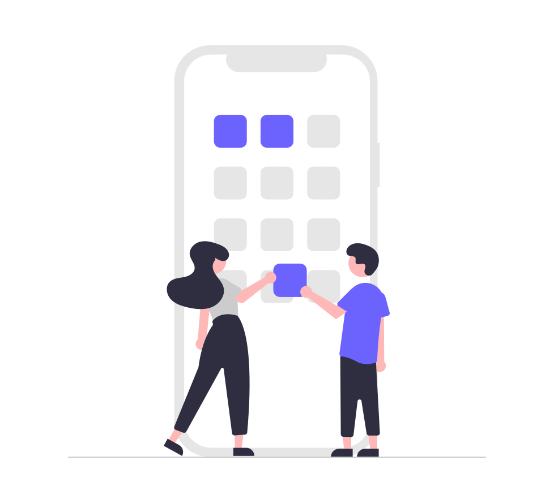
MOBILE APP DEVELOPMENT

Slide 11
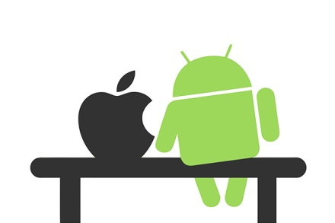
OPERATING SYSTEM

Slide 12
Different OS
MS-DOS (Microsoft Disk Operating System)
single user operating system meaning only one user can operate at a time. It does not support graphical interface hence mouse cannot be used to operate it.
Windows OS
LINUX OS (Open source OS)
Solaris OS
Symbian OS
Android Mobile OS
iOS Mobile Operating System

Slide 13

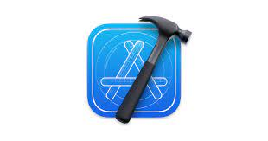




ANDROID IOS
Platform used to create an application
IDE
INTEGRATED DEVELOPMENT ENVIRONMENT
Xcode
LANGUAGES
NATIVE APPLICATIONS
software program that is developed for use on a particular platform or device.

Slide 14
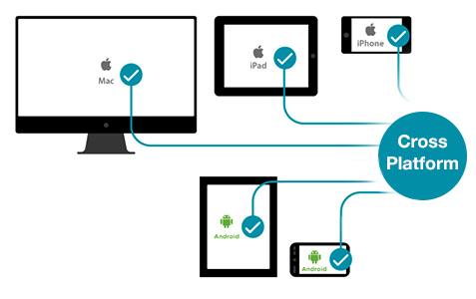


CROSS PLATFORM
computer software that is designed to work in several computing platforms. a cross-platform application may run on Microsoft Windows, Linux, and macOS.

Slide 15
1.NATIVE APPLICATIONS
2.CROSS PLATFORM APPLICATIONS
3.?

Slide 16

WEB APPLICATION
WORKING ON BROWSER
OS INDEPENDENT

Slide 17
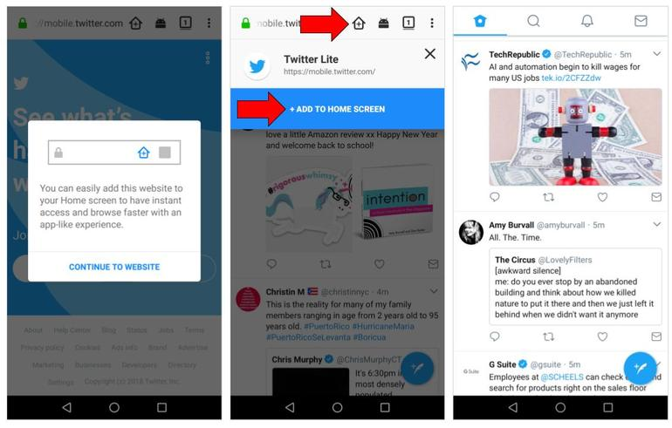
PWA
Progressive Web App

Slide 18
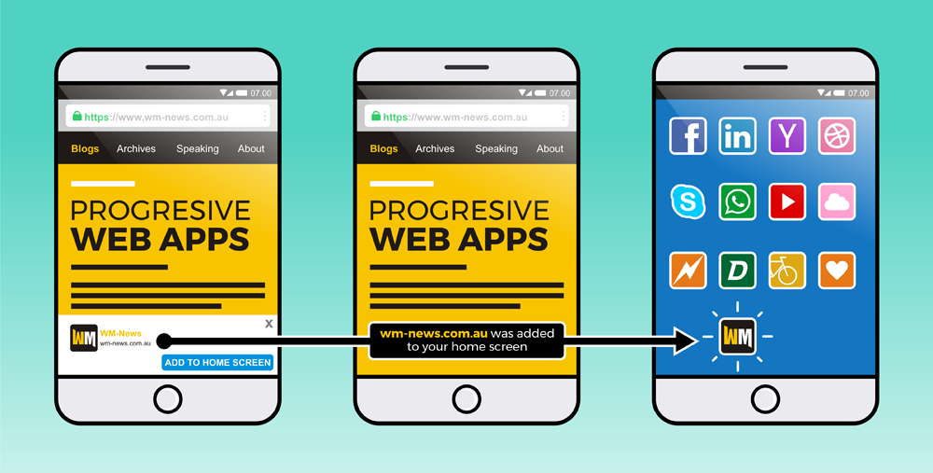

Slide 19
ADVANTAGES OF WEB APPLICATION
Do not need to be downloaded or installed—web apps function in-browser.
Easy to maintain—they have a common codebase regardless of mobile platform.
Will update themselves
Quicker and easier to build than mobile apps
Do not require app store approval, so can be launched quickly.

Slide 20
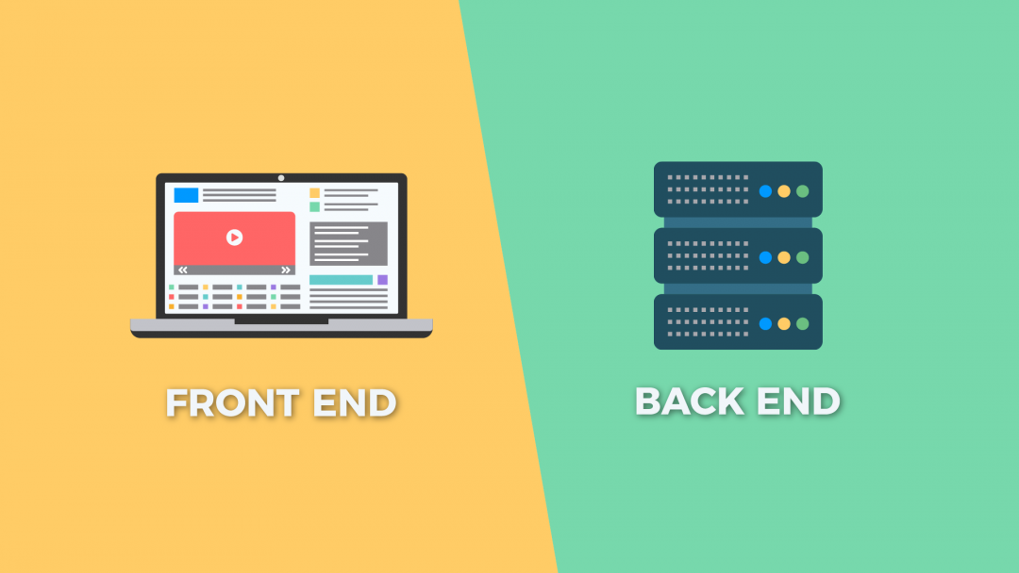
WEB DEVELOPMENT

Slide 21
FRONT END
Front-end web development also known as client-side development
It is the practice of producing HTML, CSS and JavaScript for a website or Web Application so that a user can see and interact with them directly
Web designing

Slide 22
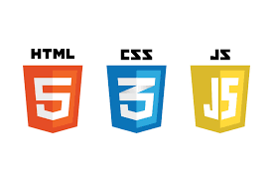
WEB DESIGNING
HTML
CSS
JAVASCRIPT

Slide 23
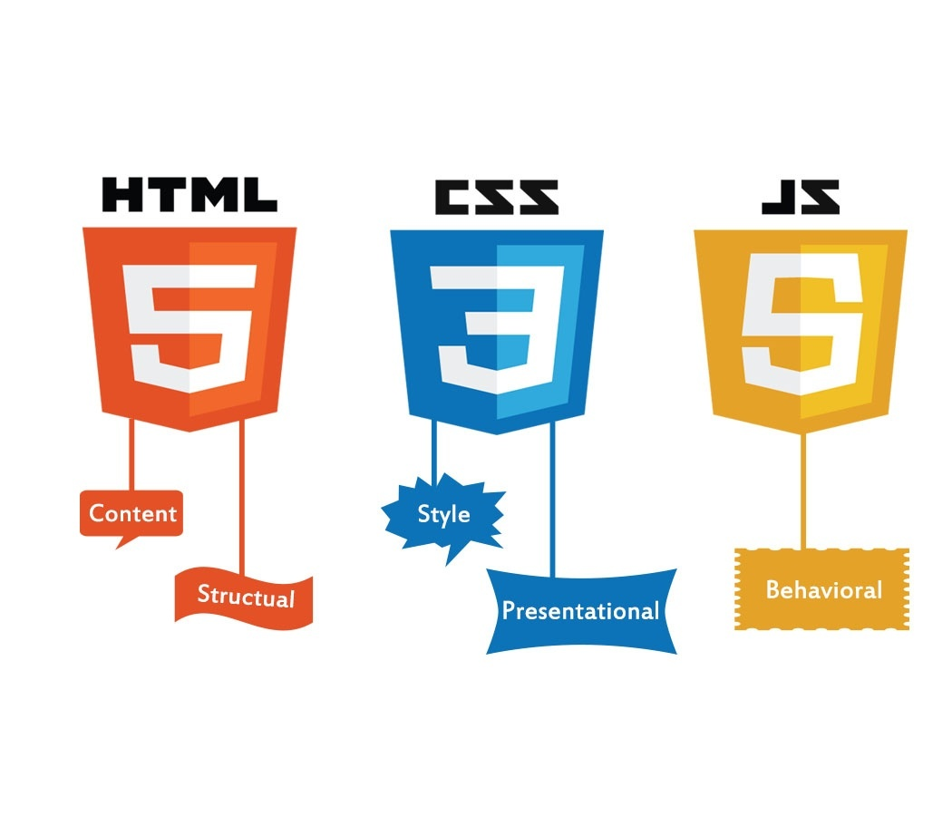

Slide 24
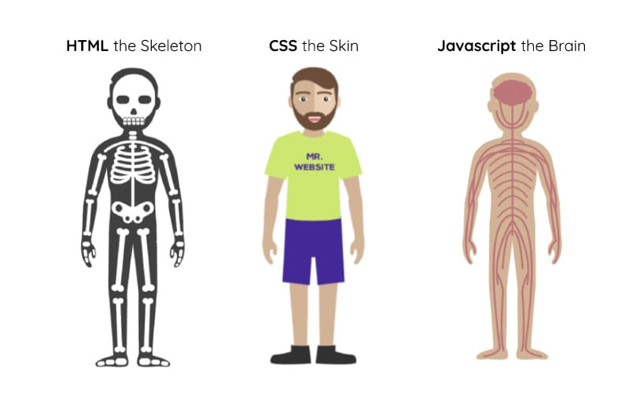

Slide 25

RESPONSIVE WEB DESIGN
It means that the web content or layout is flexible to fit within the different screen sizes where they are displayed
EXAMPLES:___

Slide 26
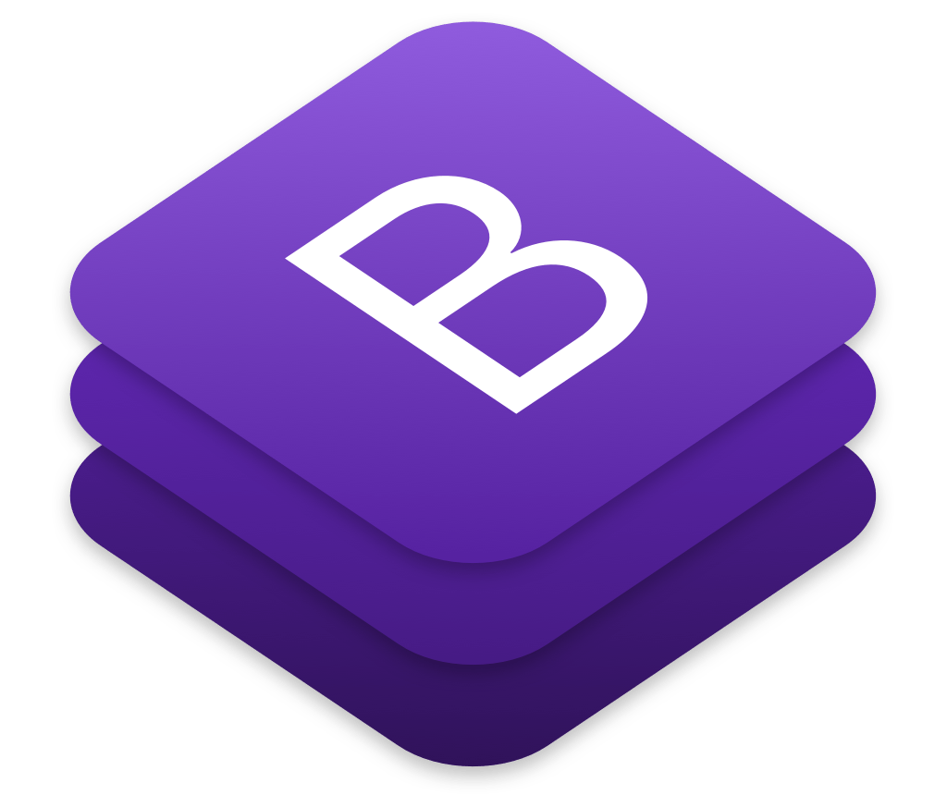
BOOTSTRAP
free and open source front end development framework for the creation of websites and web apps. (It’s not a language)

Slide 27
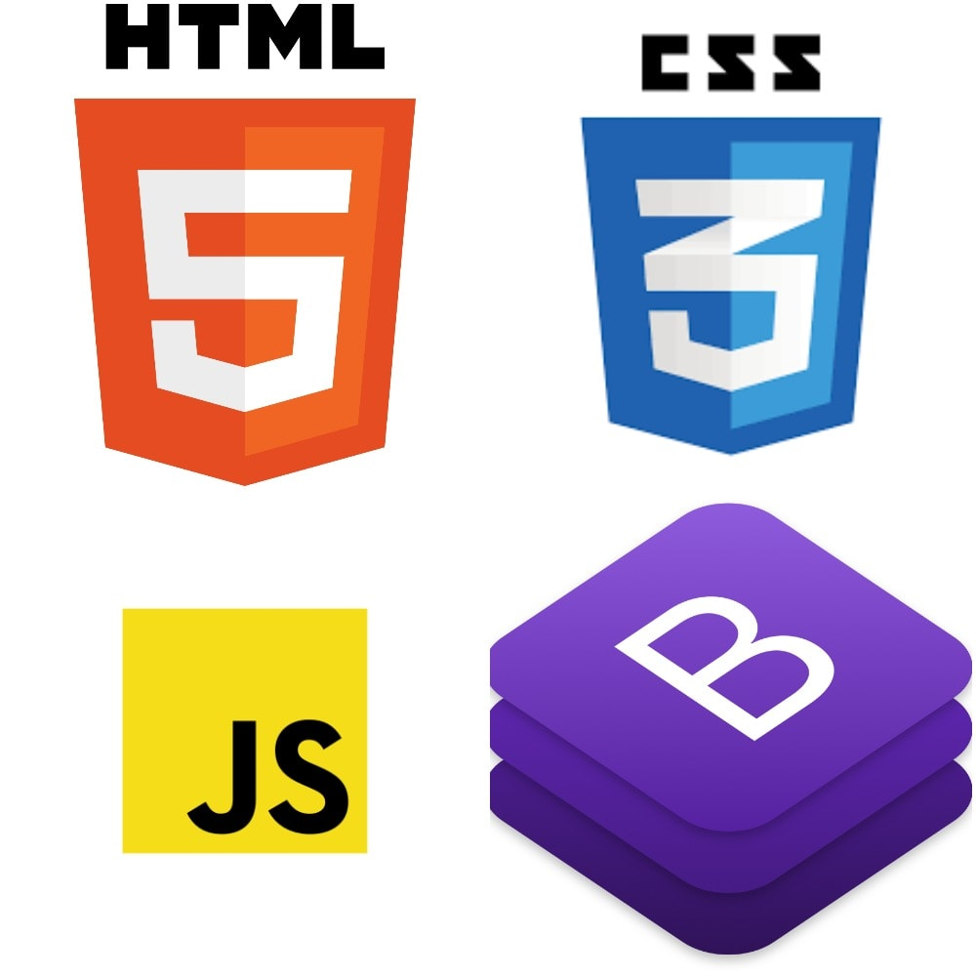
WEB DESIGNING TOOLS

Slide 28
STATIC vs DYNAMIC
In static web pages, Pages will remain same until someone changes it manually. In dynamic web pages, Content of pages are different for different visitors

Slide 29
BACKEND
In the computer world, the "backend" refers to any part of a website or software program that users do not see
Backend is the "data access layer," while the frontend is the "presentation layer.“
Server side
Programming languages are used
EXAMPLE:_____

Slide 30








BACKEND LANGUAGES

Slide 31
Case:Login
Run time
Data lose
Permanent storage ?

Slide 32

Database

Slide 33
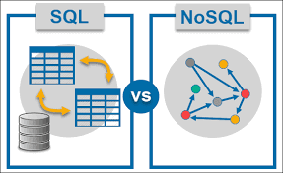
Classification of DB

Slide 34
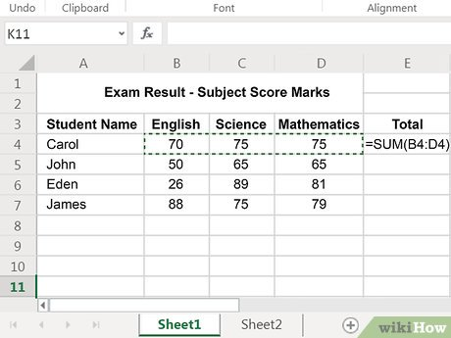
SQL
Structured Query Language
Table format

Slide 35


SQL EXAMPLES

Slide 36
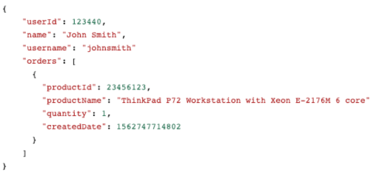
NoSQL
NoSQL databases (aka "not only SQL") are non-tabular databases
The main types are document, key-value

Slide 37


NoSQL EXAPMPLES

Slide 38
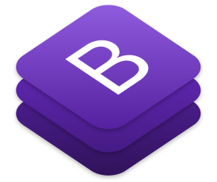
WebEd
BACK END
Programming Language
Database
FRONT END

Slide 39



ADDITIONAL INFO
FRONT END

Slide 40


ADDITIONAL INFO
BACK END

Slide 41


GIT AND GITHUB
GIT-Git is a version control system that lets you manage and keep track of your source code history
GITHUB-GitHub is a code hosting platform for version control and collaboration. It helps you and others to work together on projects from anywhere

Slide 42
Thank you
KARTHIK SUNIL
3rd Year ECE
Flutter Full stack developer

